Slide 1
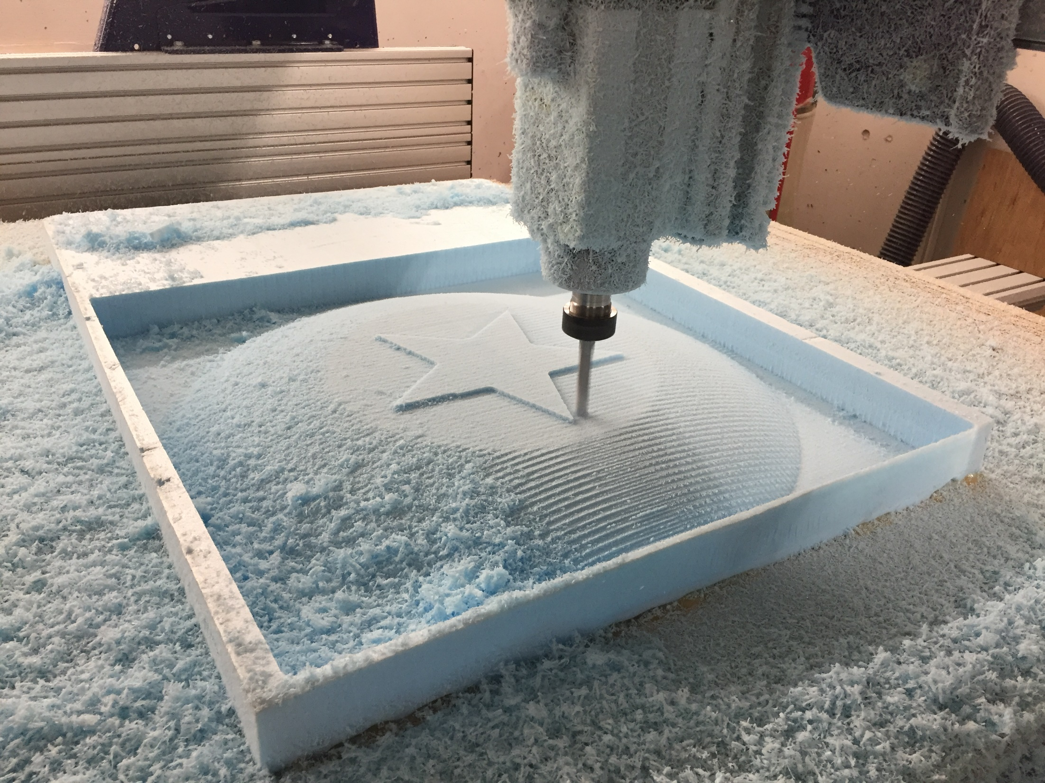
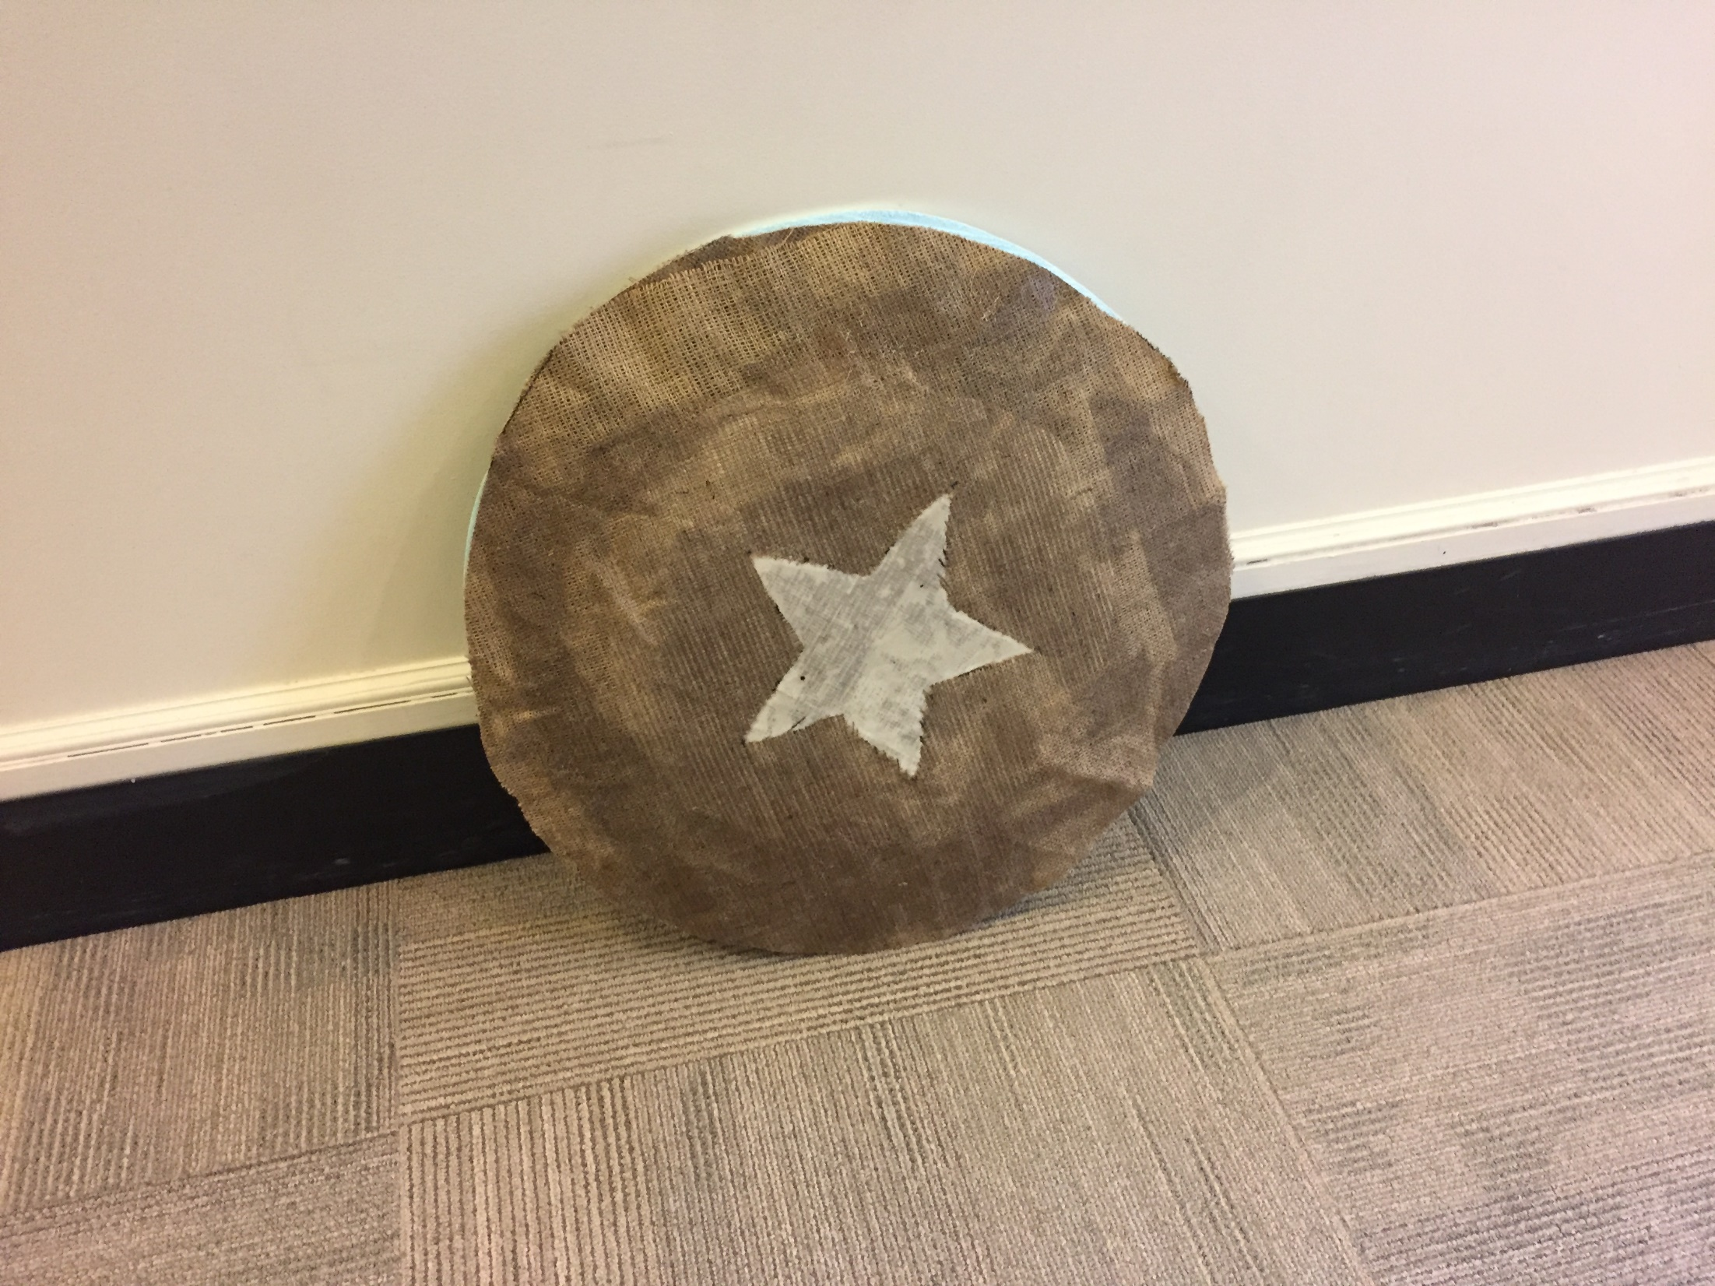
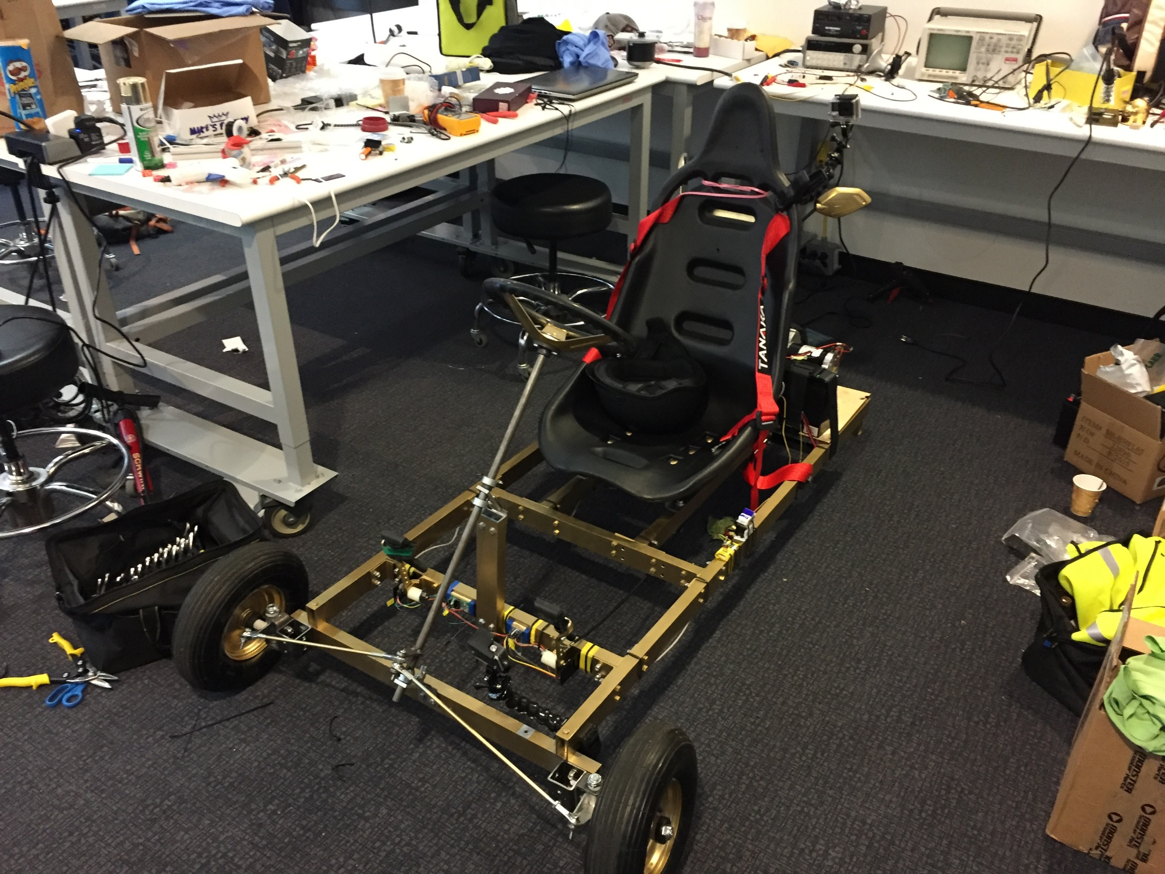
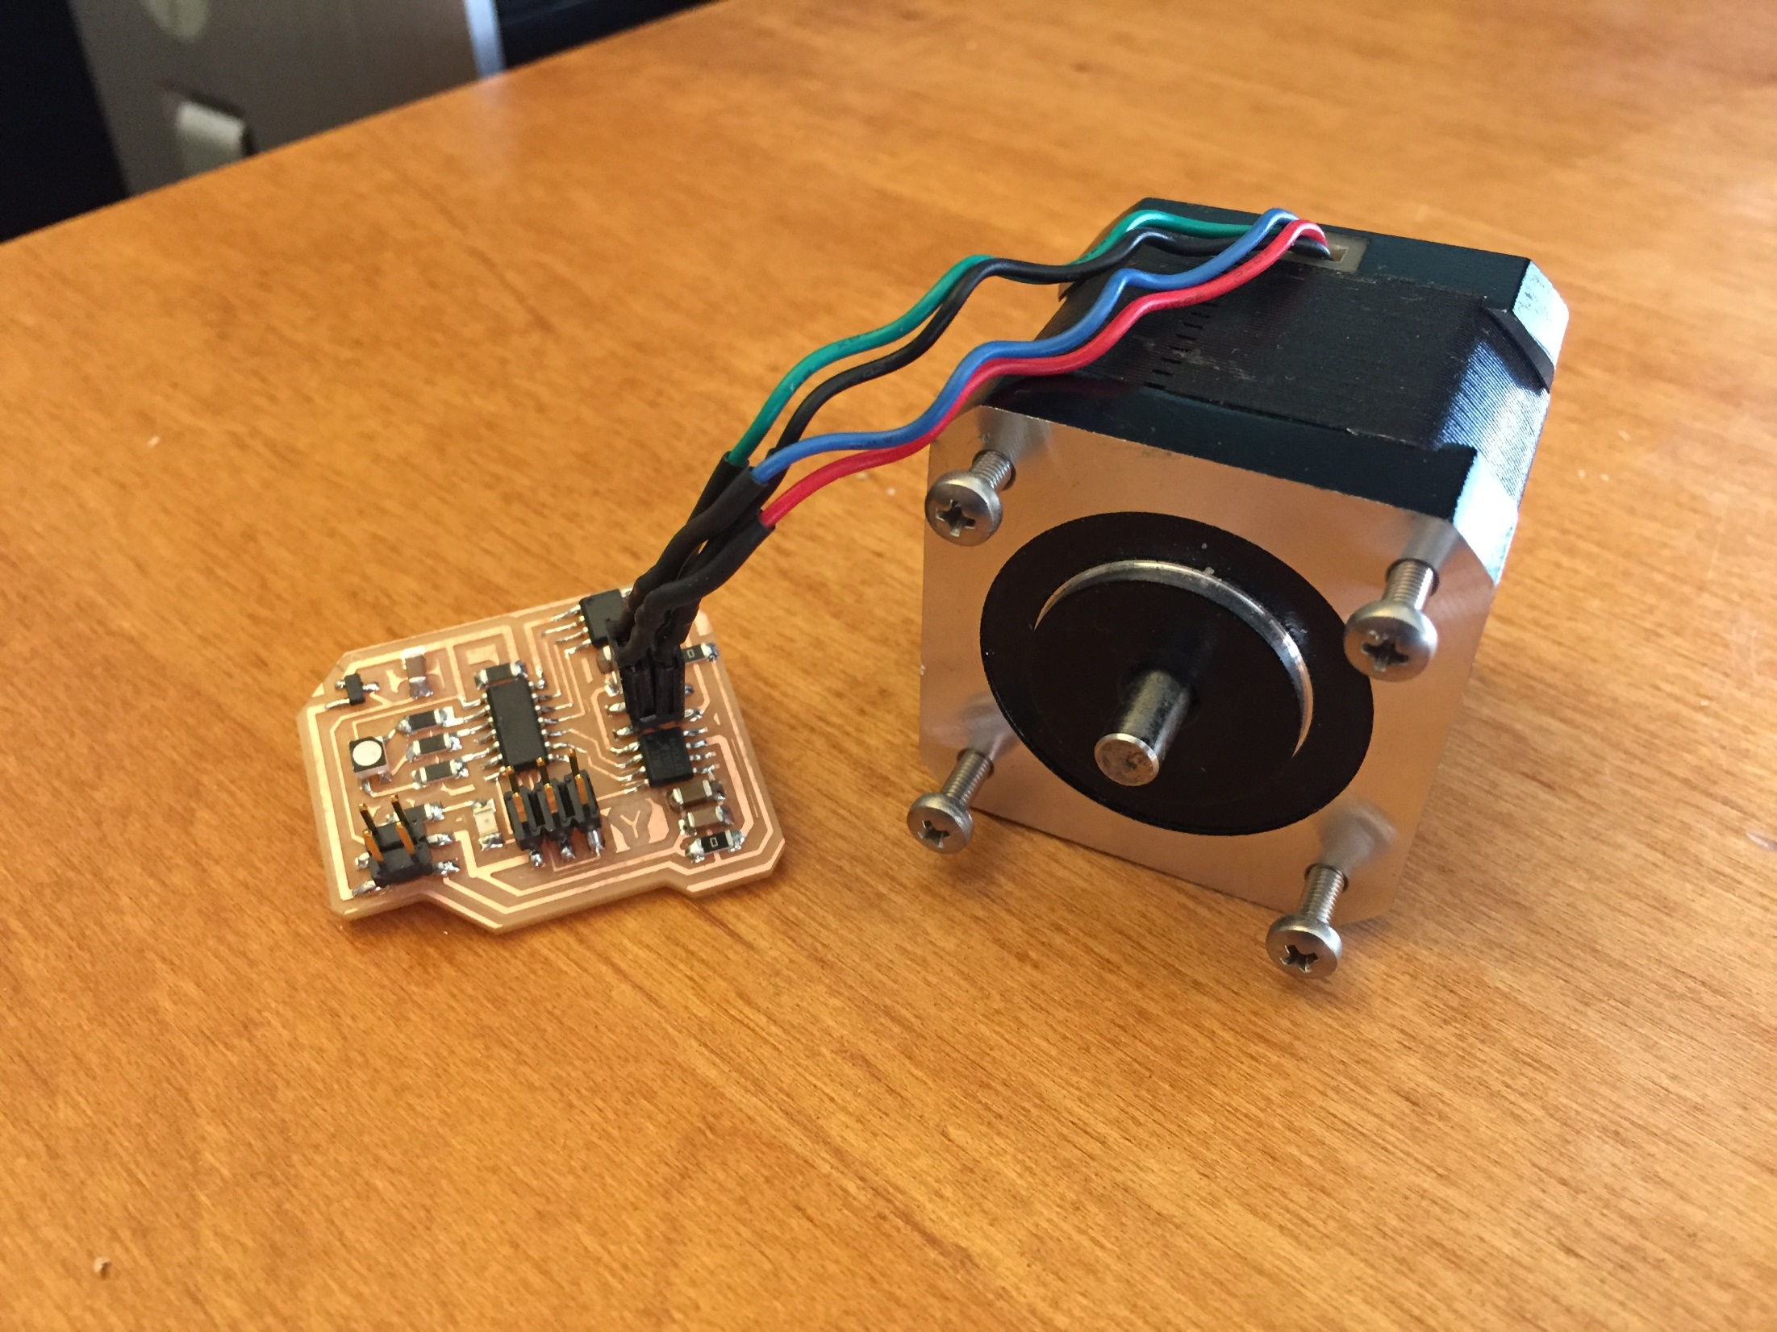
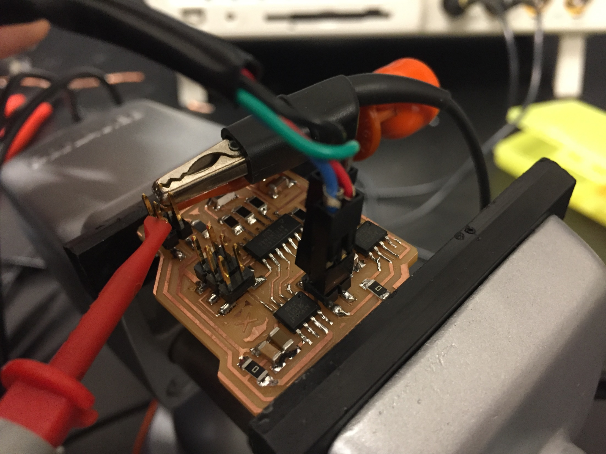
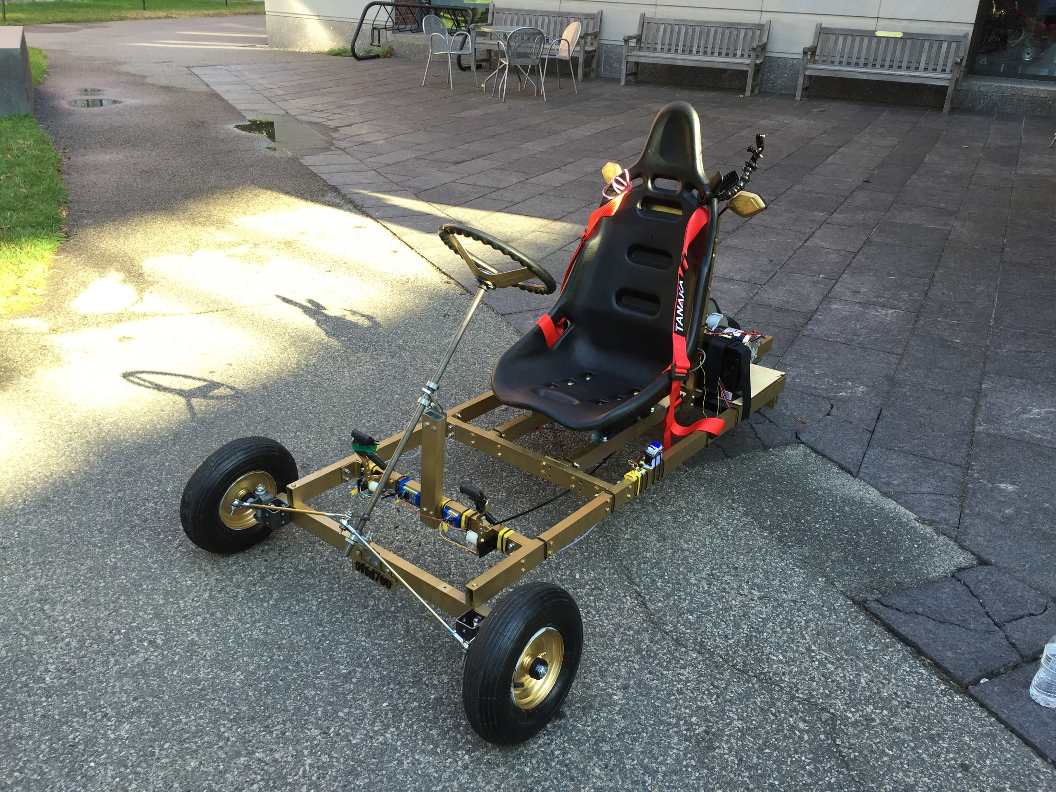
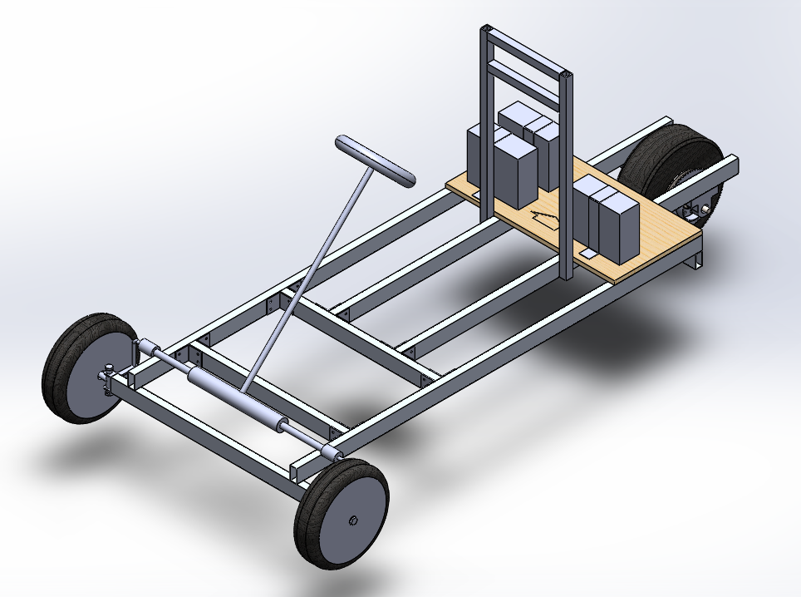
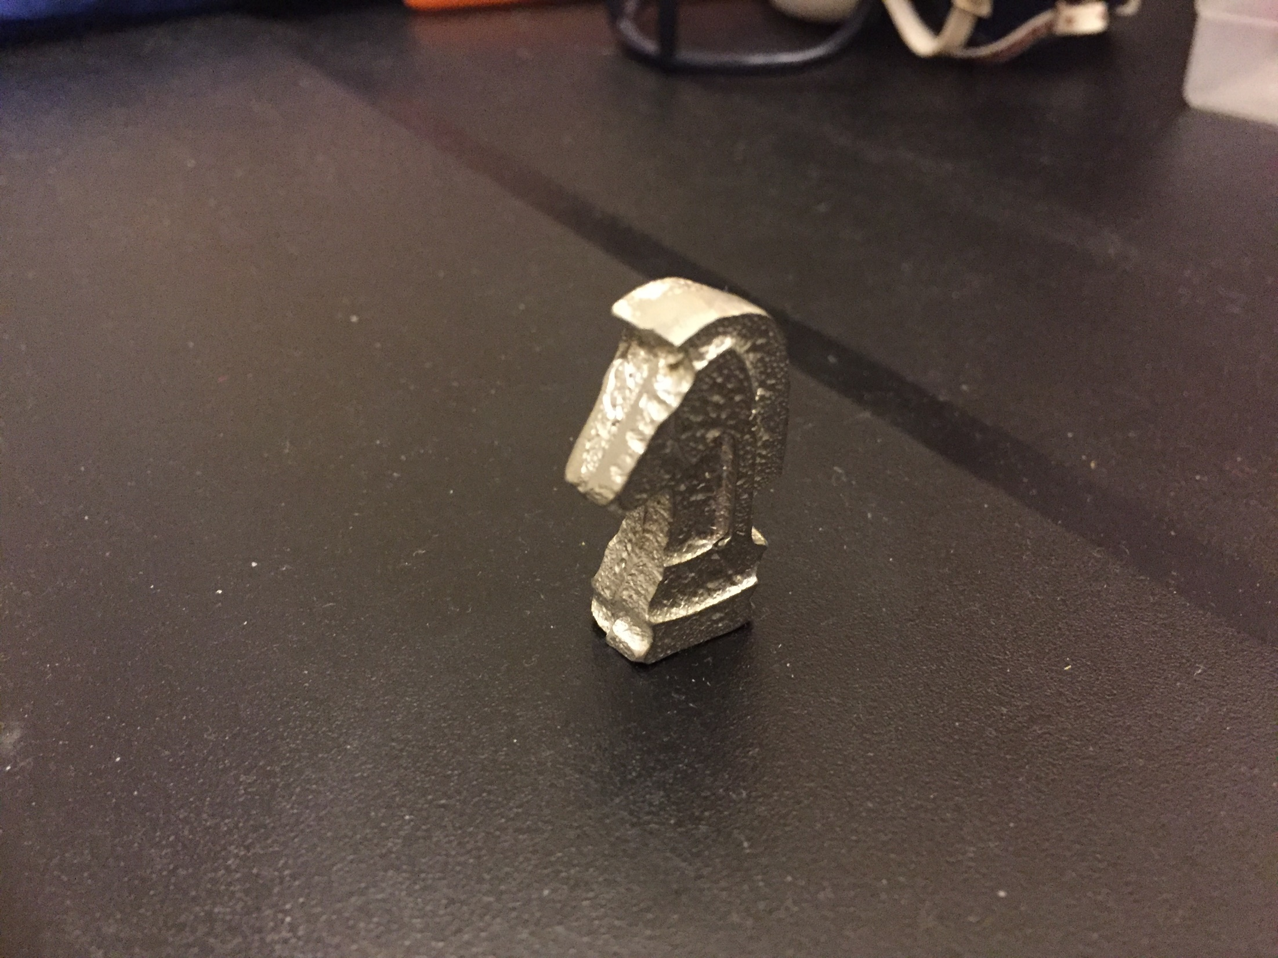
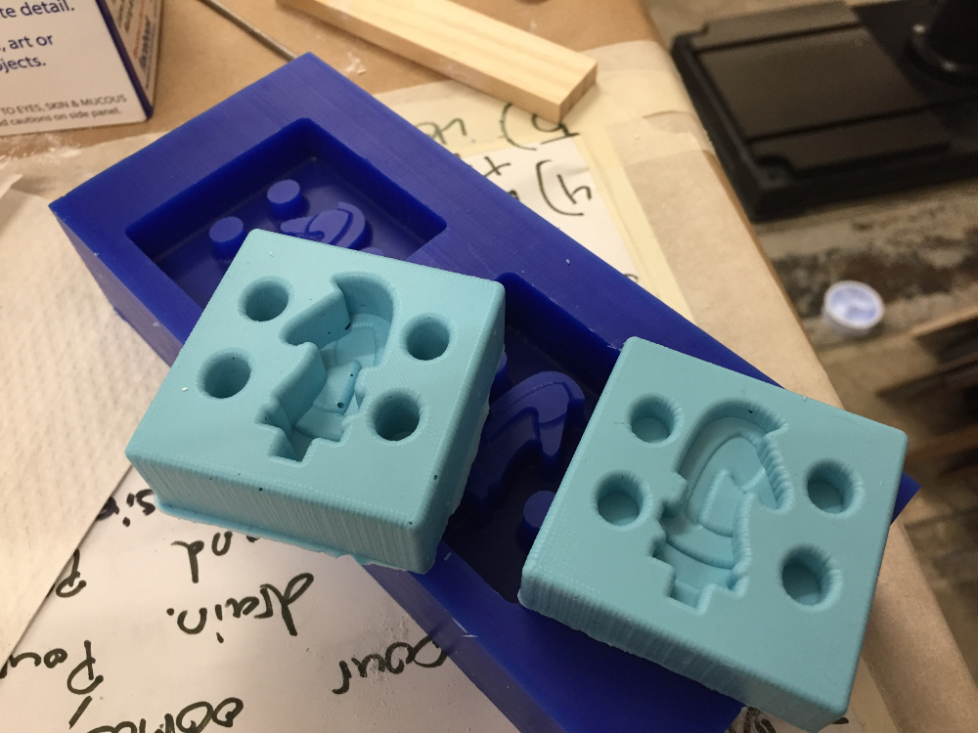

Slide 2
System
Contains
Arduino (System)
Contains
Microcontroller
Contains
Microprocessor

Slide 3
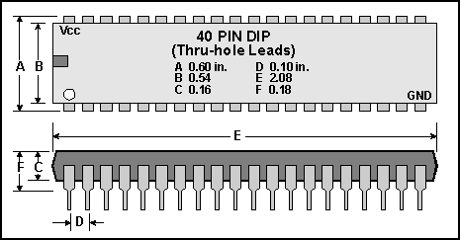
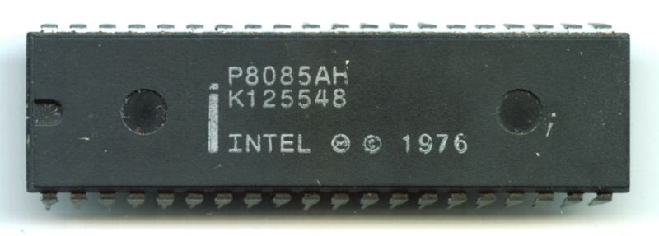
My name is Cameron Akker and I'm a full-stack inventor.
No, not a full-stack developer - I partake in projects that span the entire spectrum of creating things. I'm one part mechanical engineer, two parts electrical engineer, one part software developer, and two parts entrepreneur.
My name is Cameron Akker and I'm a full-stack inventor.
No, not a full-stack developer - I partake in projects that span the entire spectrum of creating things. I'm one part mechanical engineer, two parts electrical engineer, one part software developer, and two parts entrepreneur.
Cameron Akker
Harvard 2018
-- full-stack inventor.

Slide 4
cameron akker
harvard 2018
inventor
cameron akker
harvard 2018
inventor
cameron akker
harvard 2018
inventor

Slide 5
Traditional Club Leadership Structure
Co-Presidents
Upper Leadership Board
Other Leadership/Retuning Members
New Associates
HackHarvard Leadership Structure
Core Team
Board Members (Old and New)

Slide 6
HackHarvard Organizational Structure
Logistics
Hacker Relations
Partnerships
Design
Event Agenda
Food Purchases
Transportation
MLH
Volunteers
Room Scheduling
Marketing
Application Management
Social media
Mentors/judges
Interhackathon relationships
Corporate Sponsorships
In-Kind Sponsorships
Talks
Workshops
Budget
Supports all other teams
Website Design
Logo/branding
Banners
Stickers
Email template

